Slide 1
Andrew Geens
and
Pavlos Konstantinidis
The Technical Team
at
CIBSE Certification Ltd

Slide 2
The new MHCLG Register 20th September 2020
So, what is this all about?
The contract that has been operated by Landmark since 2007/8 has come to an end
Rather than go to the market for an alternative supplier MHCLG have decided to hold energy certificate data on the www.gov.uk website
By accident or by intent this has moved the focus from certificates to data and consequently some of the processes leading up to lodging a certificate have changed
This webinar is designed help you prepare for these changes
Please do not shoot the messengers

Slide 3
Software Update requirements – xml generated by your current version will not work after 10.00 on Sunday
The new ORCalc will be available in downloads on our lodgement portal
The new iSBEM is available from 18th September at https://www.uk-ncm.org.uk/
All other software updates will be communicated to you by the vendor. We understand that most will be available by Monday 21st September

Slide 4
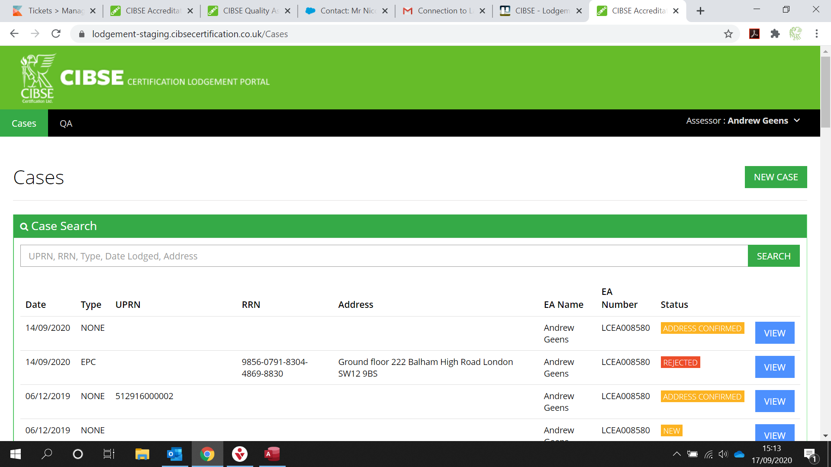
The new Lodgement process View of the cases list

Slide 5
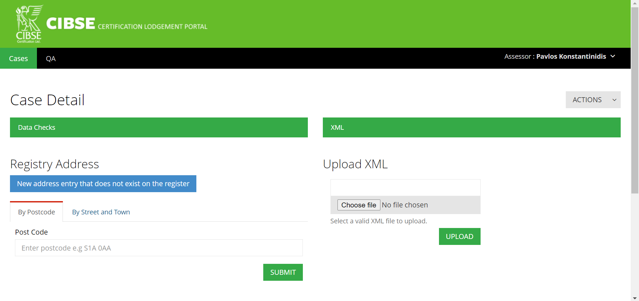
The new Lodgement process View of a new case

Slide 6
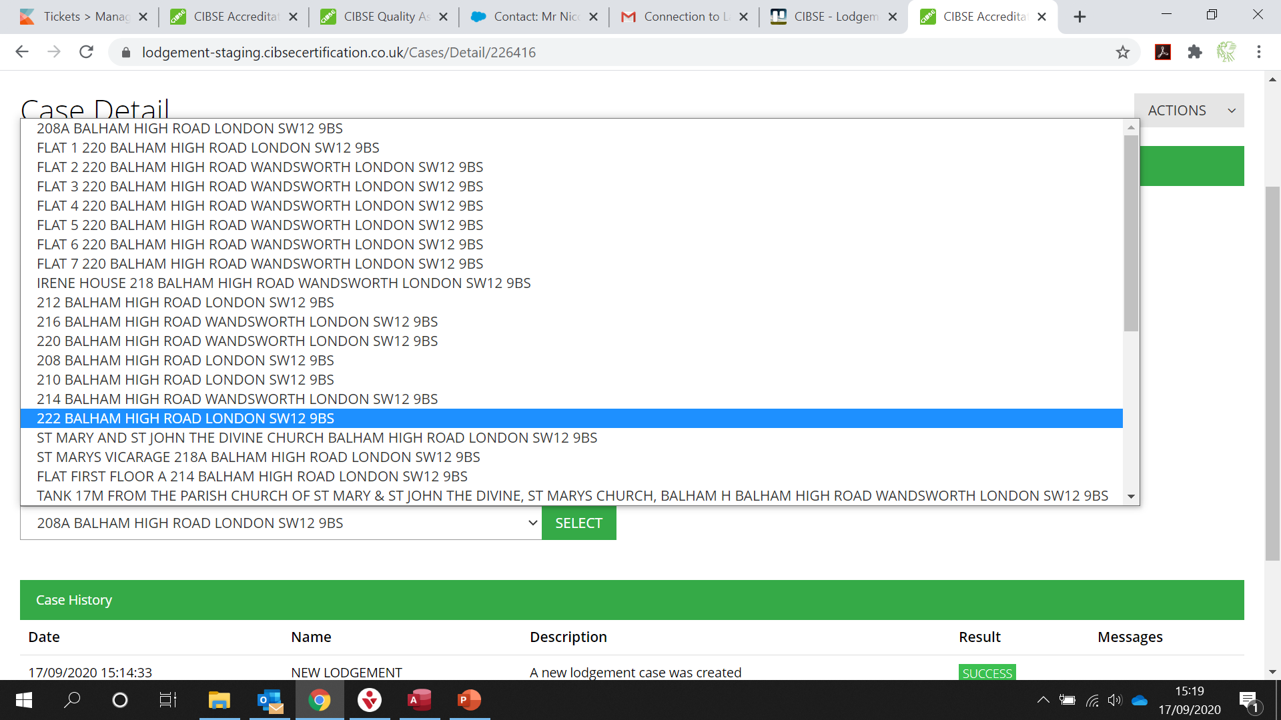
The new Lodgement process Entries in the register retrieved

Slide 7
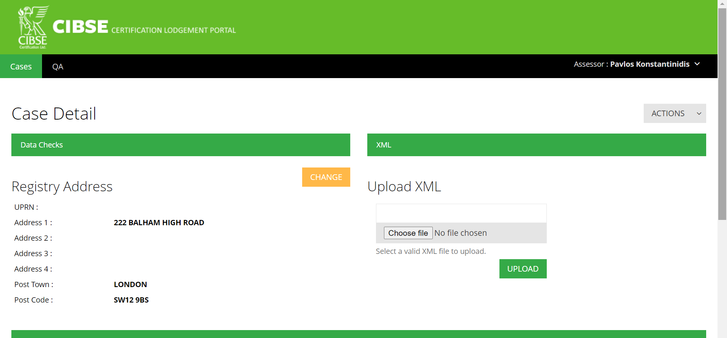
The new Lodgement process Entry from the register assigned to case

Slide 8
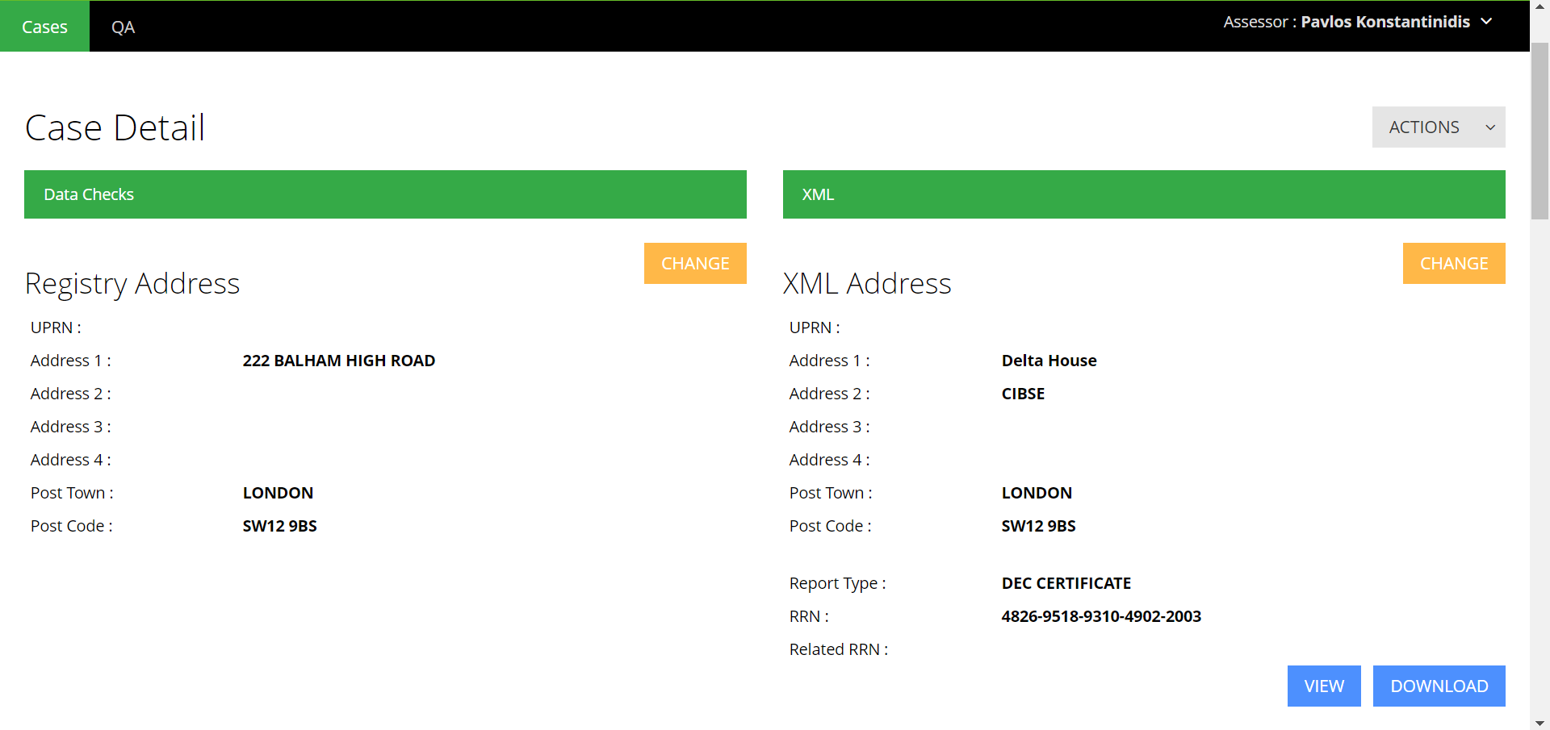
The new Lodgement process xml file uploaded (no mandatory check)

Slide 9
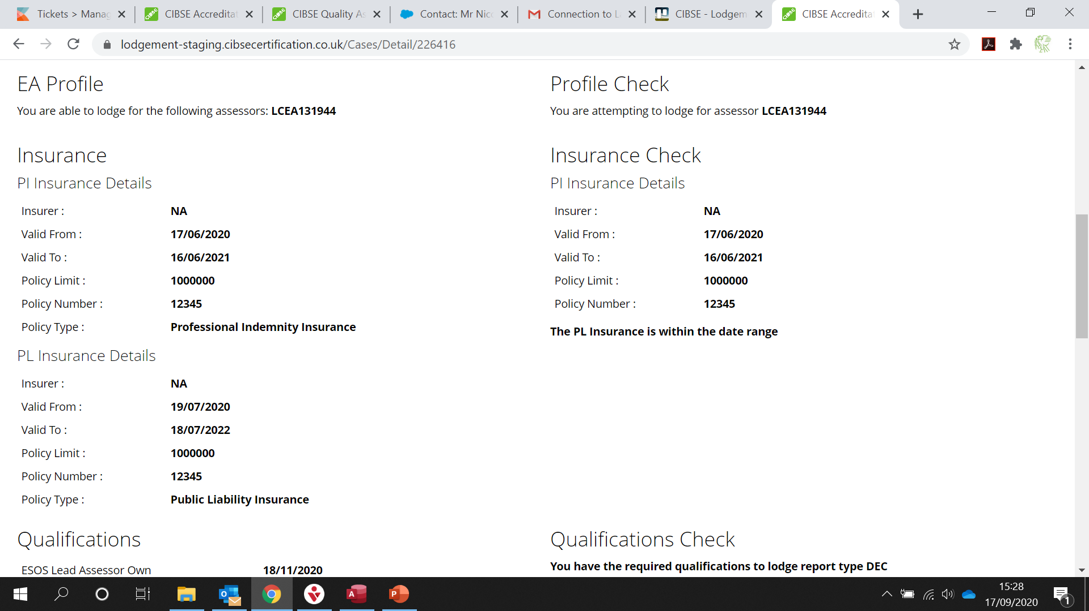
The new Lodgement process Mandatory checks

Slide 10
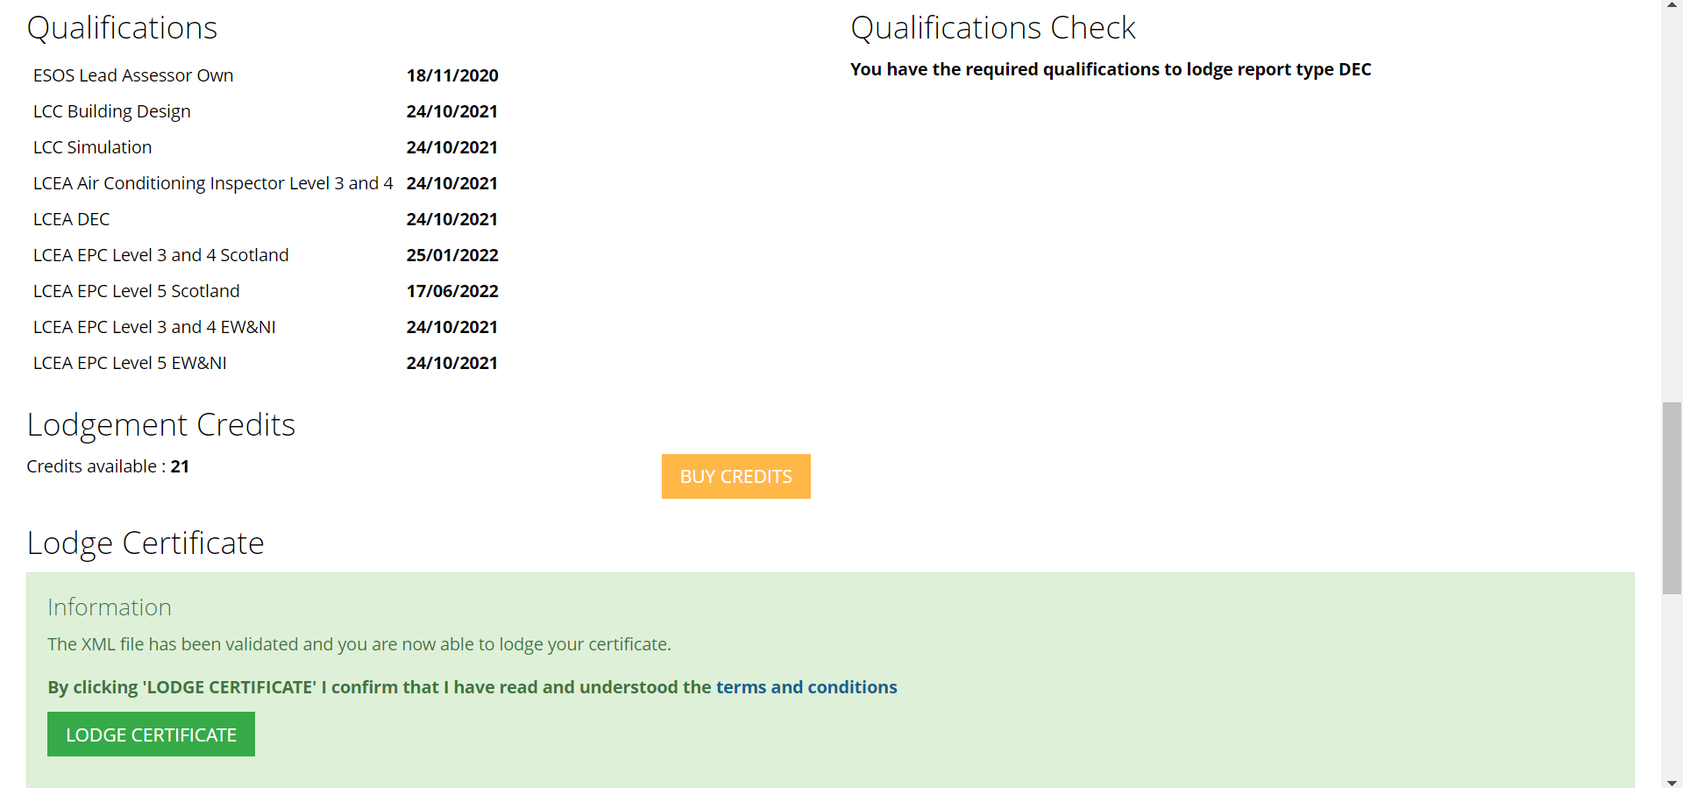
The new Lodgement process Option to lodge

Slide 11
The new Lodgement process Using the new entry option

Slide 12
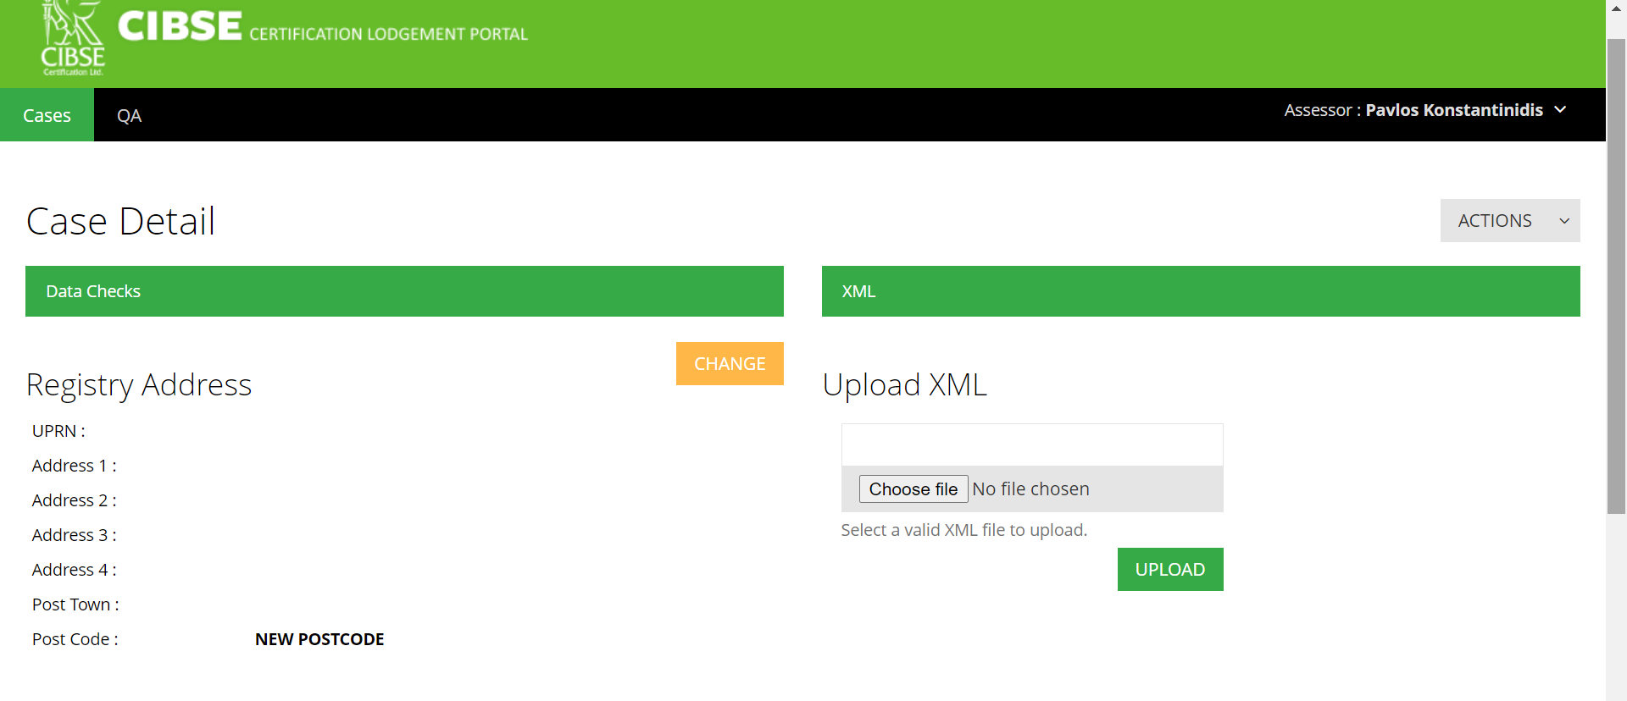
The new Lodgement process New entry option selected

Slide 13
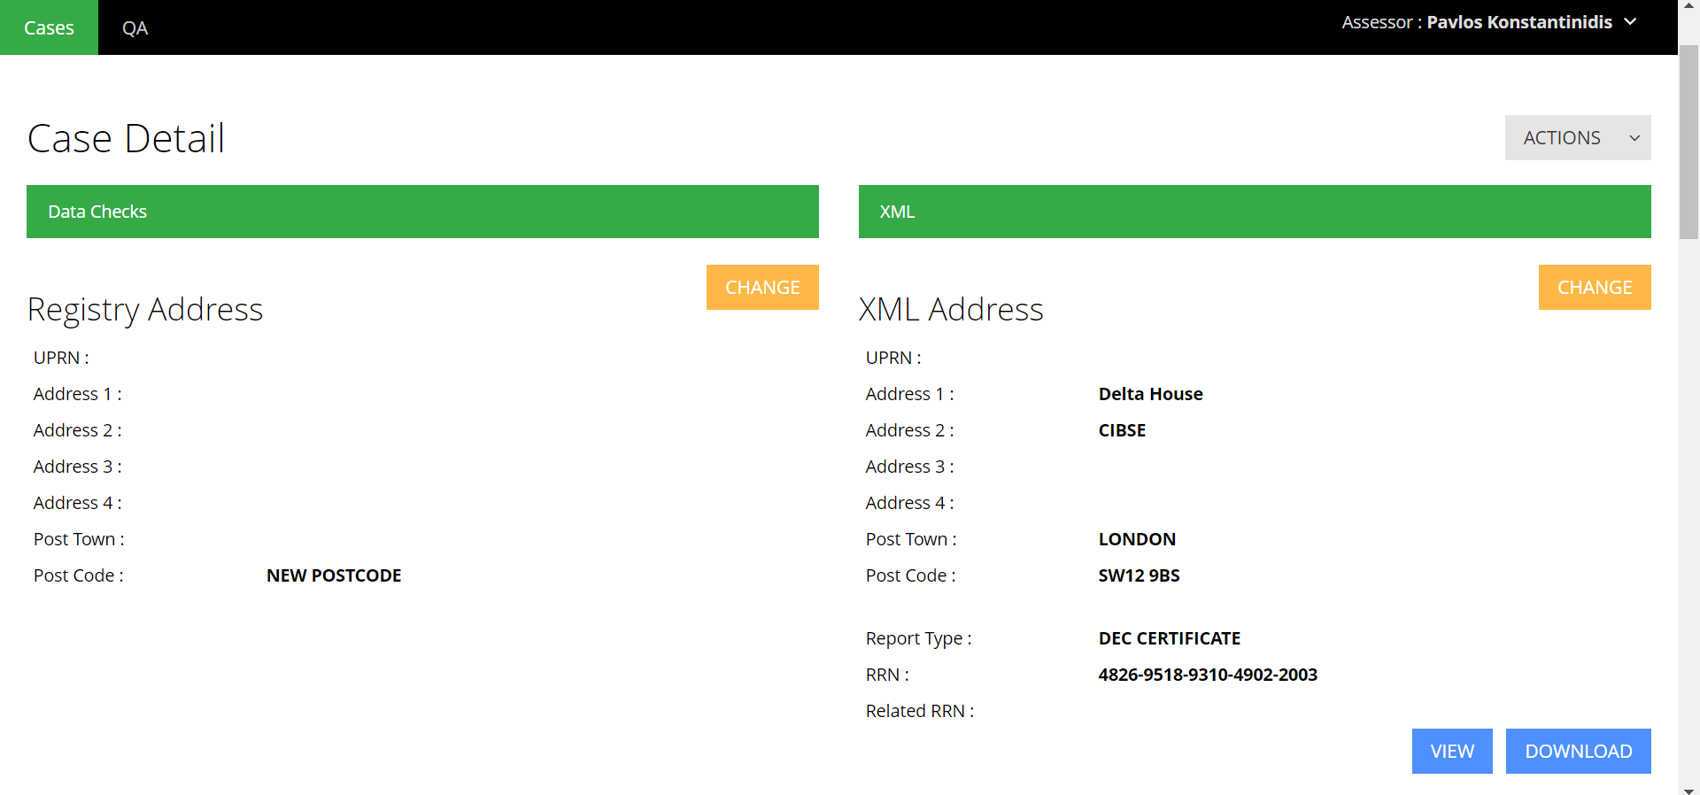
The new Lodgement process xml uploaded against a new entry

Slide 14
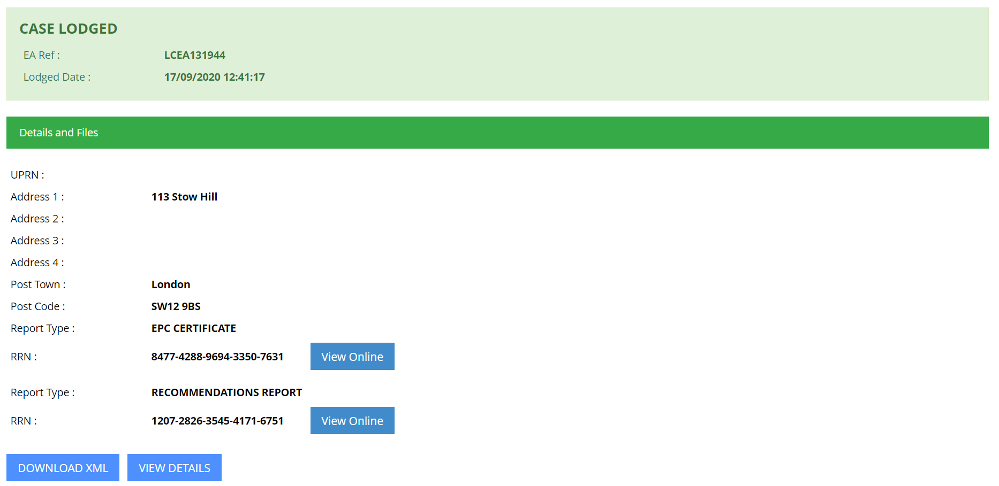
The new Lodgement process Lodged case view and certificates view

Slide 15
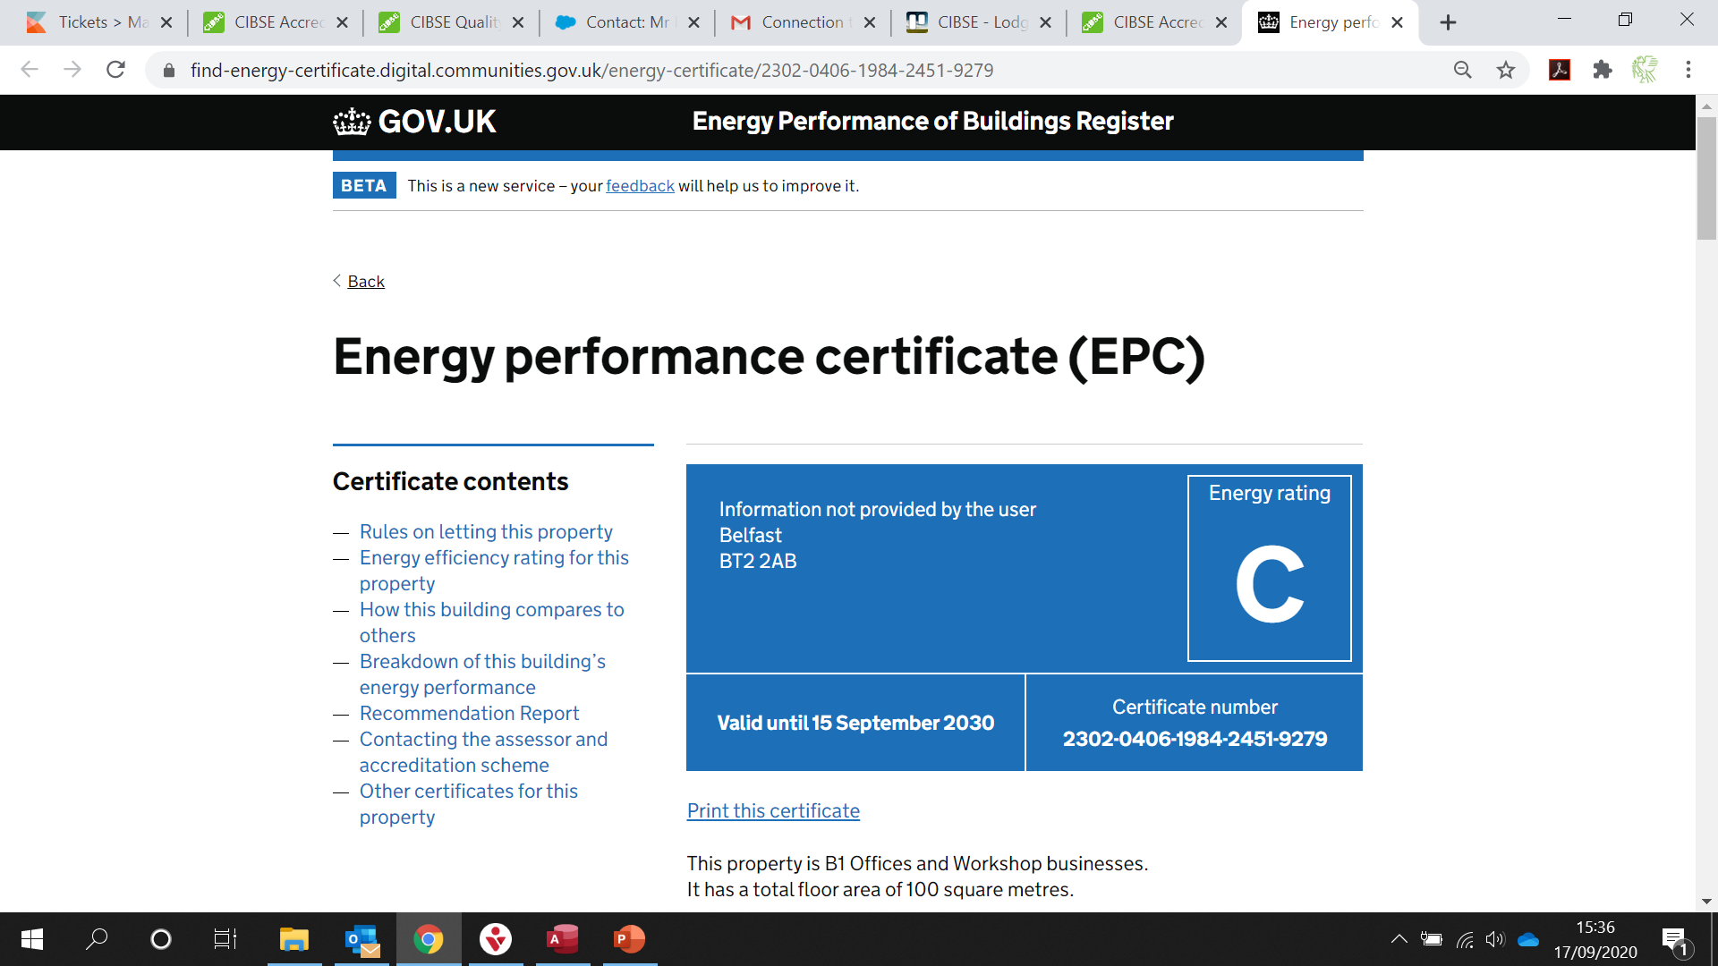
The new Lodgement process Lodged certificate view on register

Slide 16
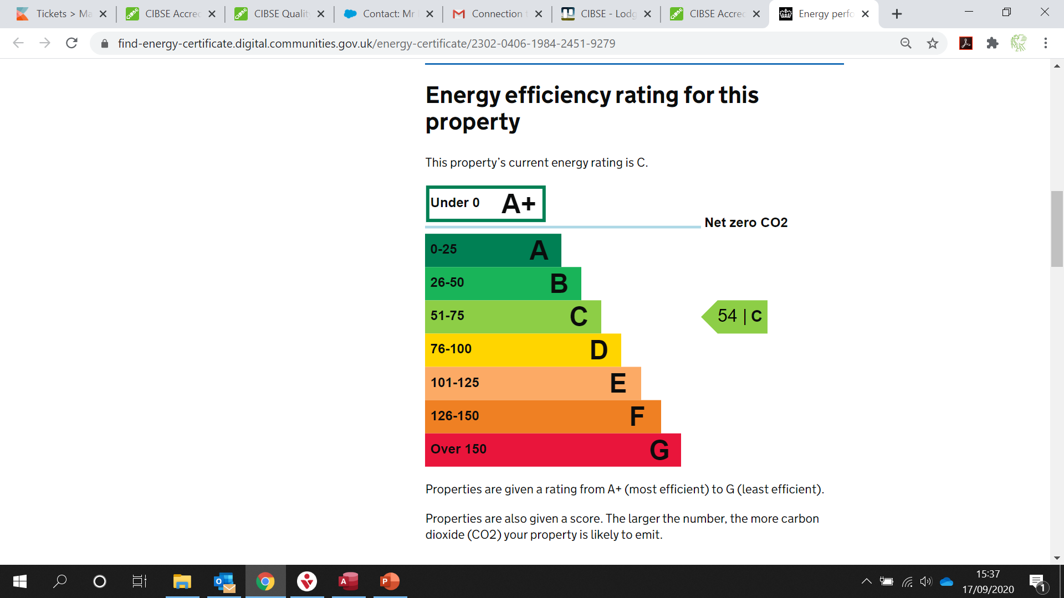
The new Lodgement process Lodged certificate view on register

Slide 17
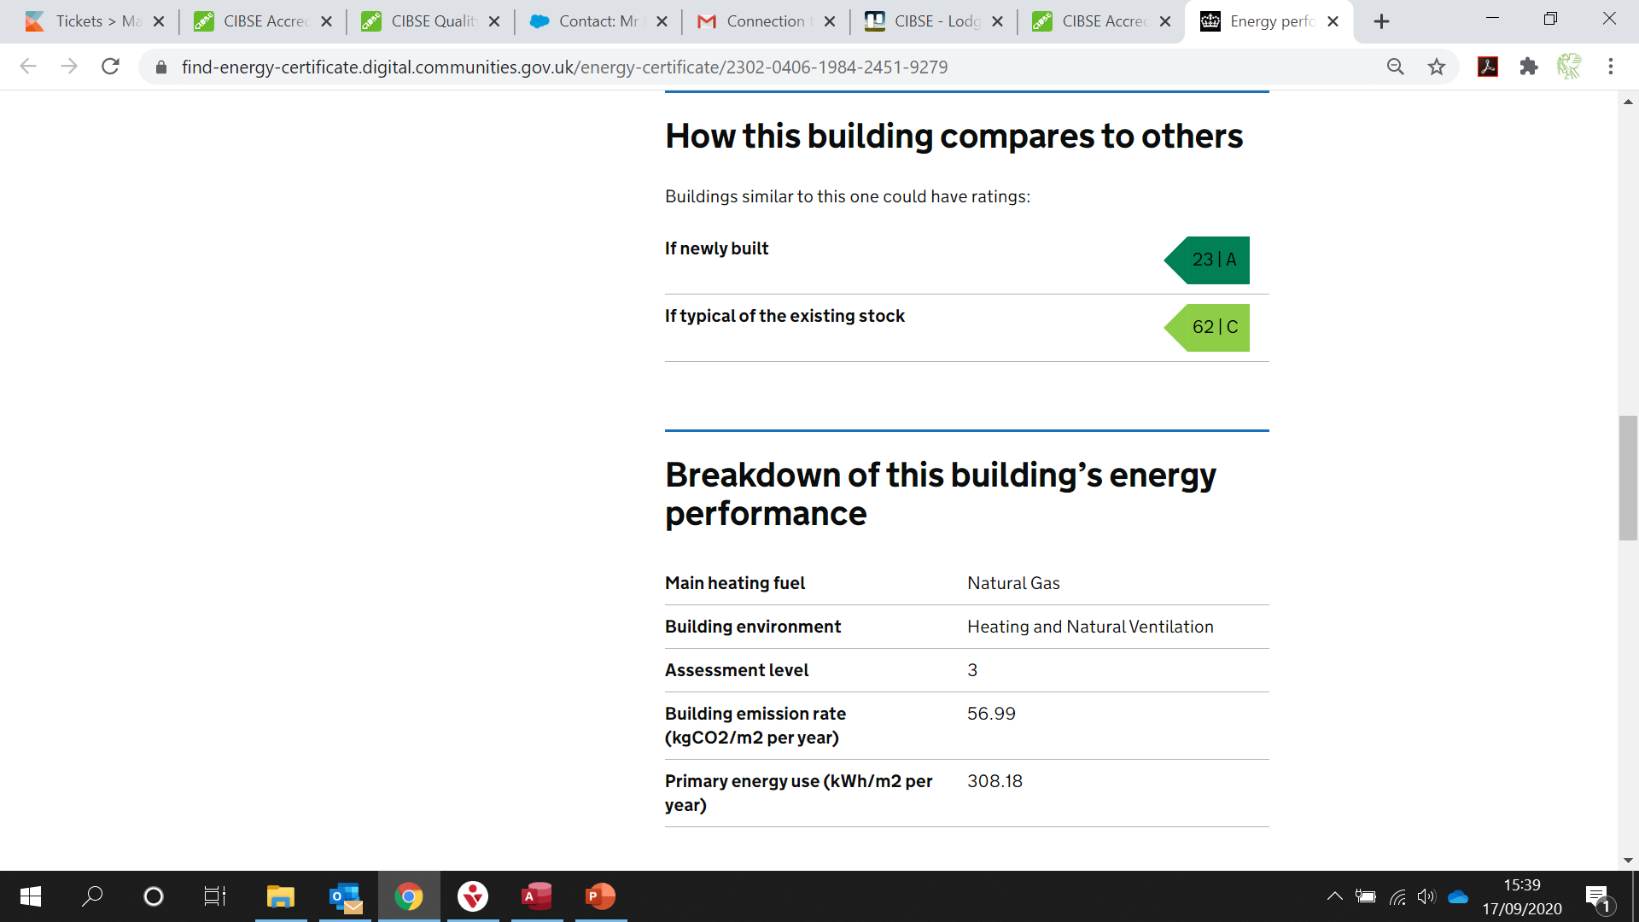
The new Lodgement process Lodged certificate view on register

Slide 18
The new Lodgement process Lodged certificate view on register

Slide 19
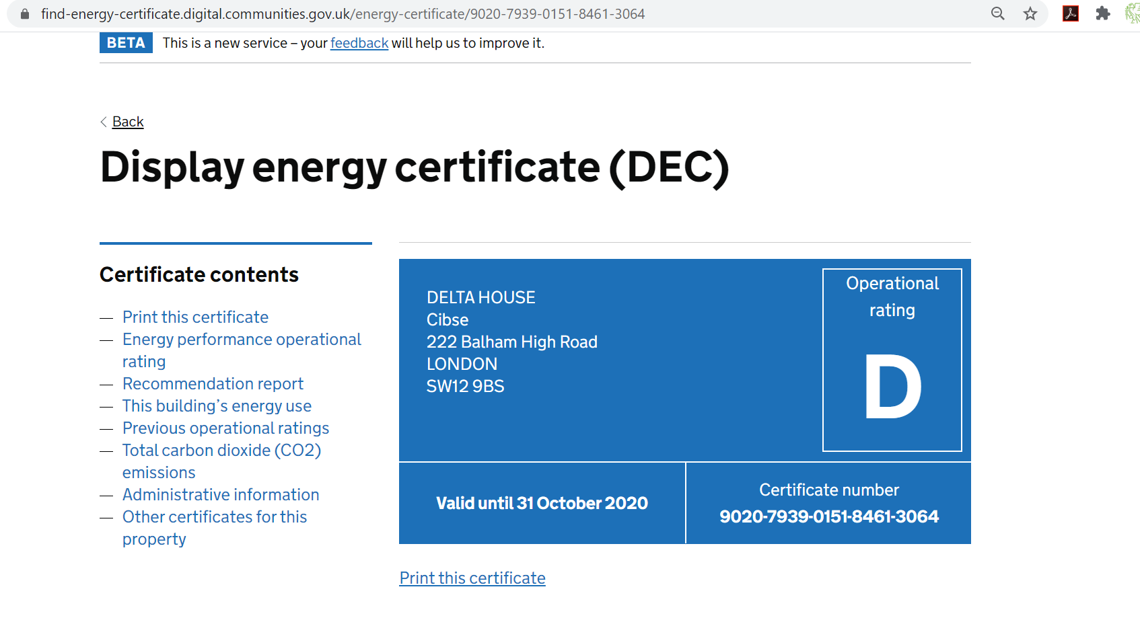
The new Lodgement process Lodged certificate view on register

Slide 20
The new Lodgement process Lodged certificate view on register

Slide 21
The new Lodgement process Lodged certificate view on register

Slide 22
The new Lodgement process Lodged certificate view on register

Slide 23
The new Lodgement process Lodged certificate view on register

Slide 24
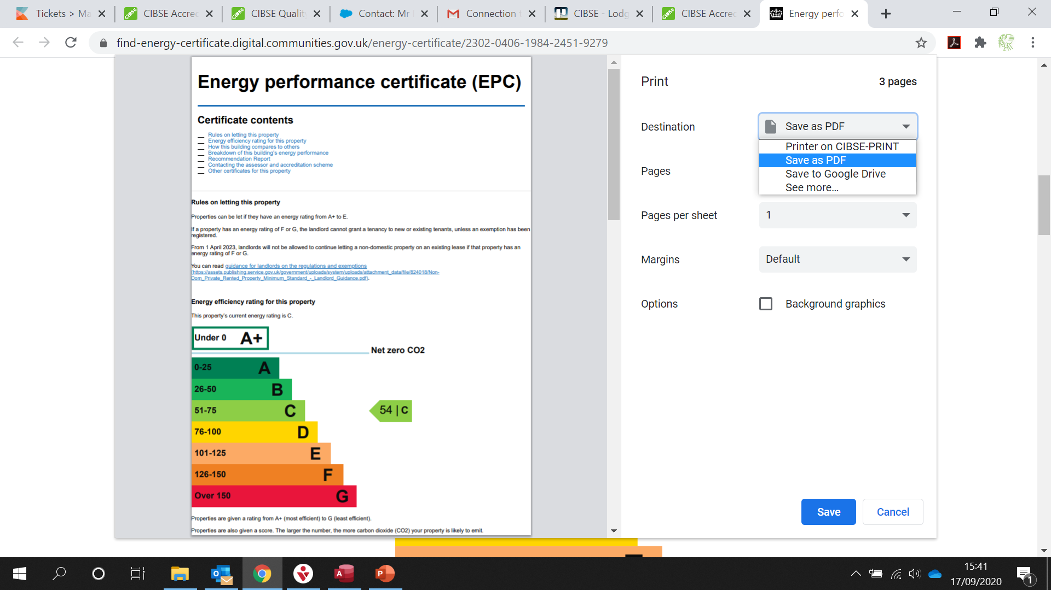
The new Lodgement process Printable version of the certificate

Slide 25
Other changes Changes in the downloads area

Slide 26
Software still produces drafts

Slide 27
Other things to mention
Previous year xml for DECs
All “Certificates” will be in one place, no separate websites for England and Wales, and Northern Ireland (Note Welsh language)
Air Conditioning Reports – No DCLG Software
No authorised user area
Feedback encouraged via the .gov.uk website
All Certificates at Landmark will be migrated

Slide 28
New URLs
https://find-energy-certificate.digital.communities.gov.uk/ for finding existing certificates and reports
https://getting-new-energy-certificate.digital.communities.gov.uk/ for finding an energy assessor to carry out an inspection

Slide 29
Any Questions?
4163
4163

